Slide 1
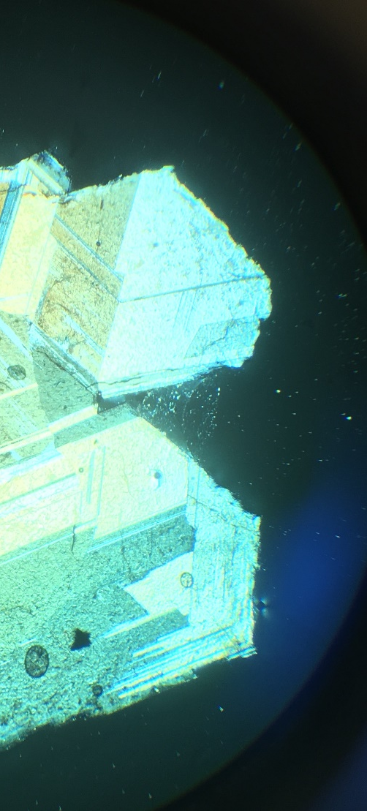
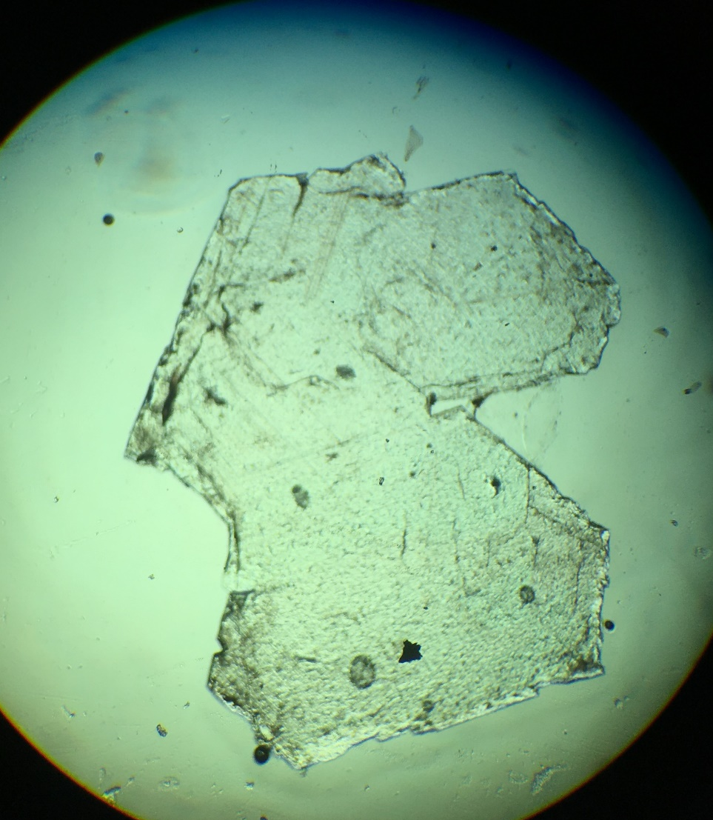
UUOP 1.9
Single grain of aragonite (carbonate: CaCO₃)

Slide 2
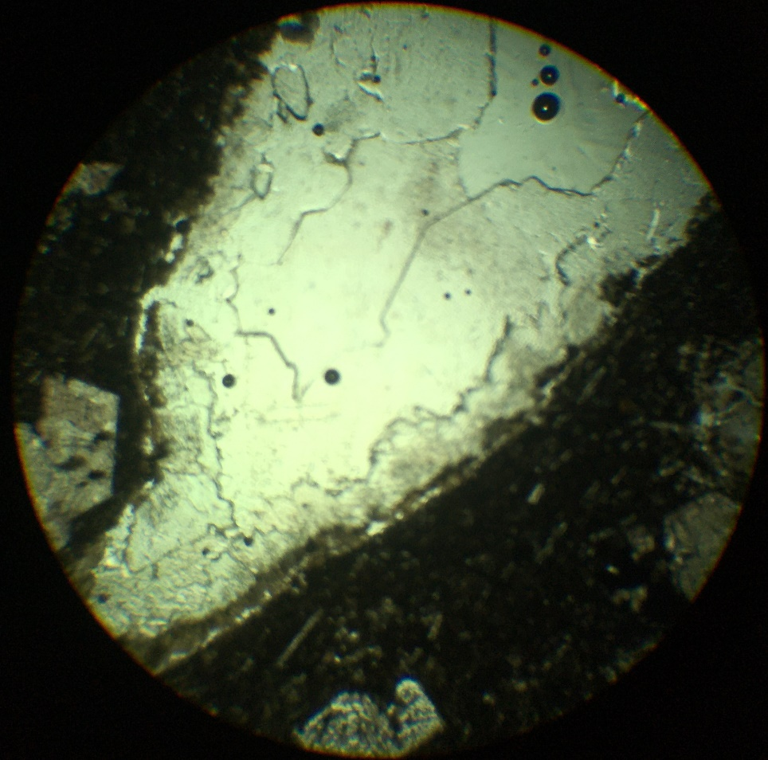
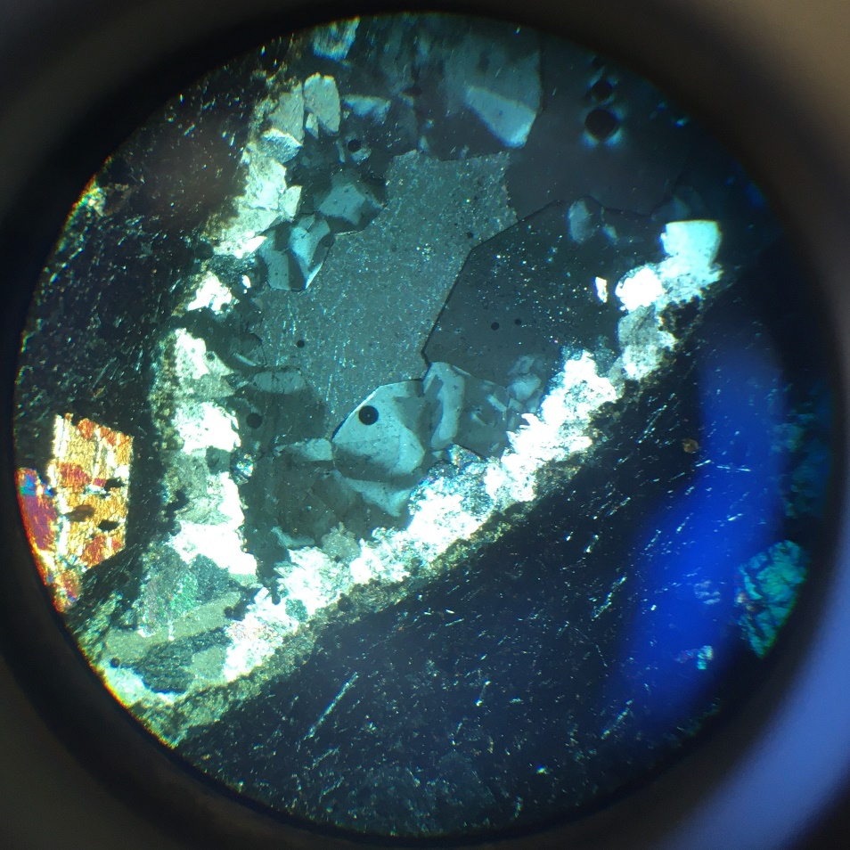
Analcime
Augite
Analcime
Calcite
UUOP 2.10
Analcime (tectosilicate): Na(AlSi₂O₆) · H₂O

Slide 3
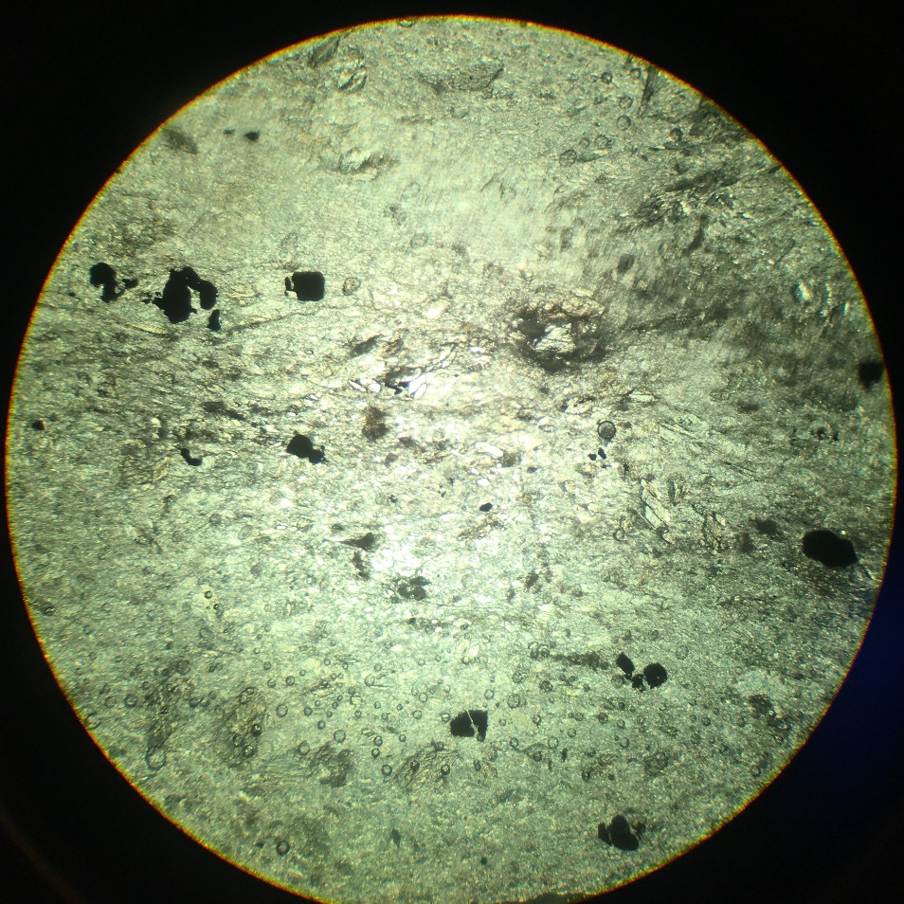
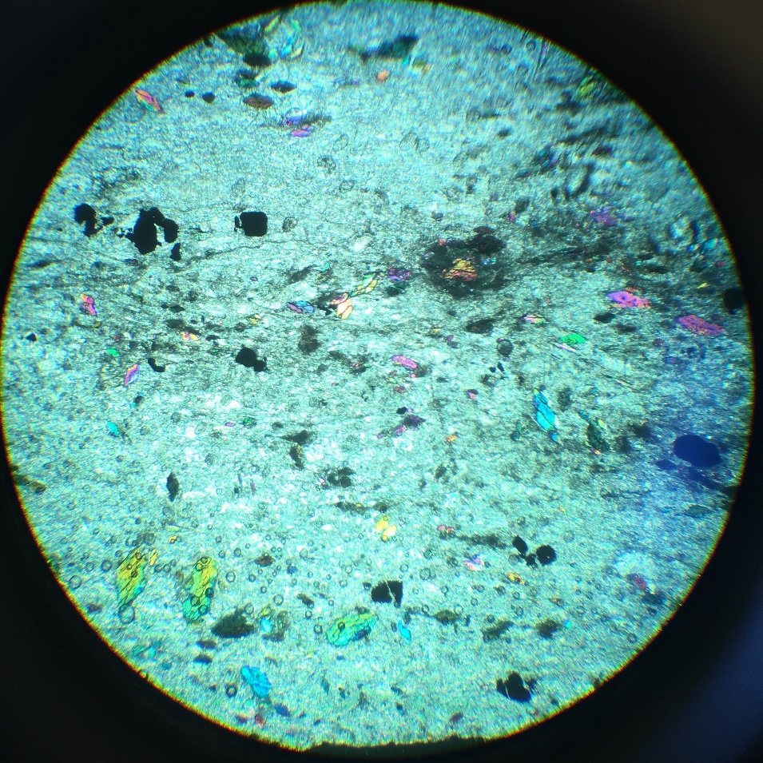
Iron oxide
talc
Augite
UUOP 3.2
Talc (Phyllosilicate - TOT): Mg₃Si₄O₁₀(OH)₂

Slide 4
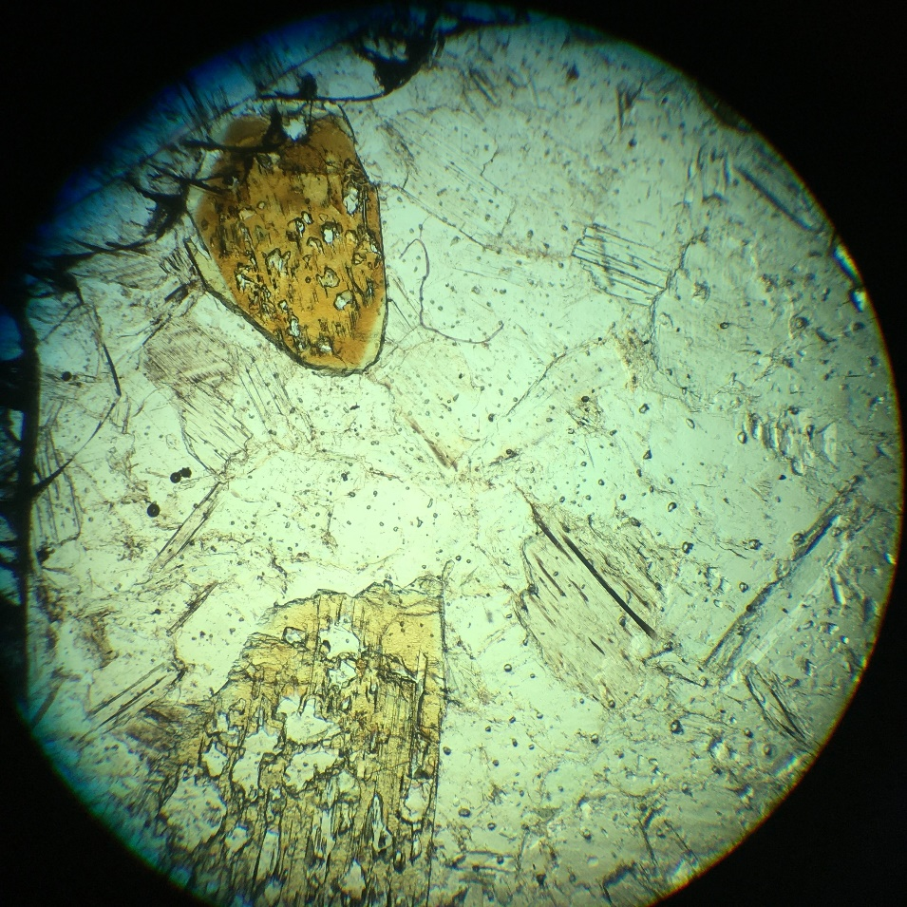
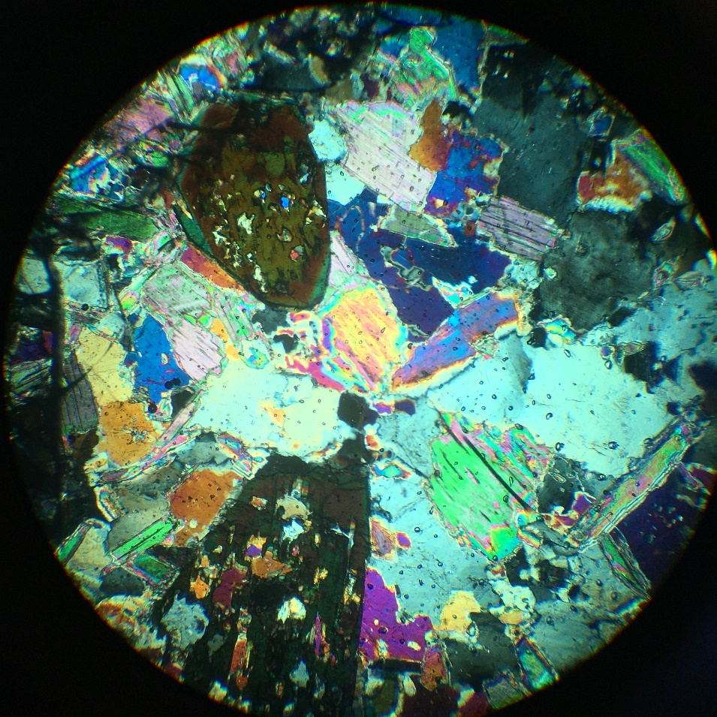
biotite
Zinnwaldite
Quartz
Muscovite
UUOP 4.4
Muscovite (phyllosilicate – TOT + cation): KAl₂(AlSi₃O₁₀)(F,OH)₂ (Zinnwaldite = white micas with higher delta than muscovite)

Slide 5
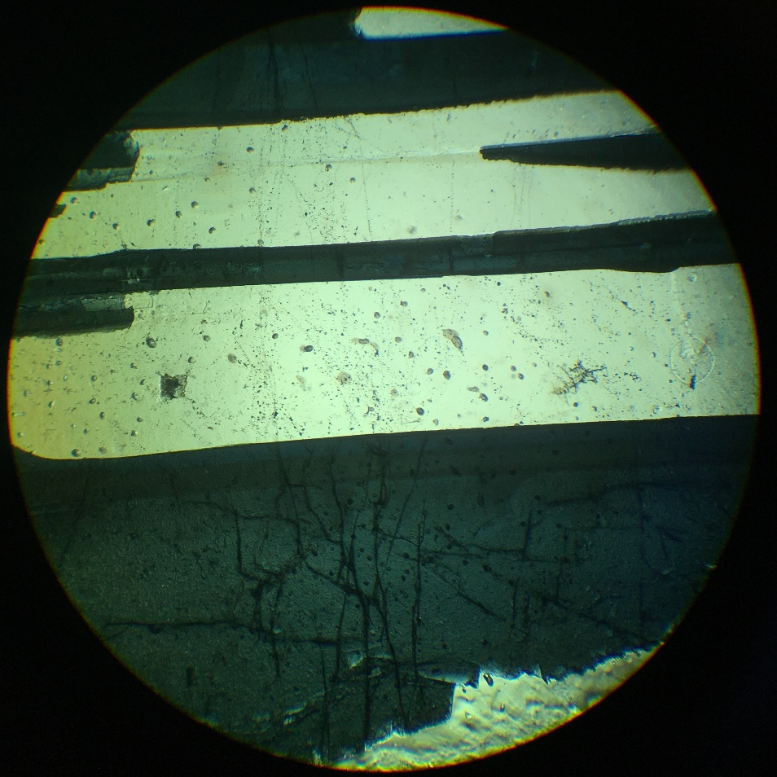
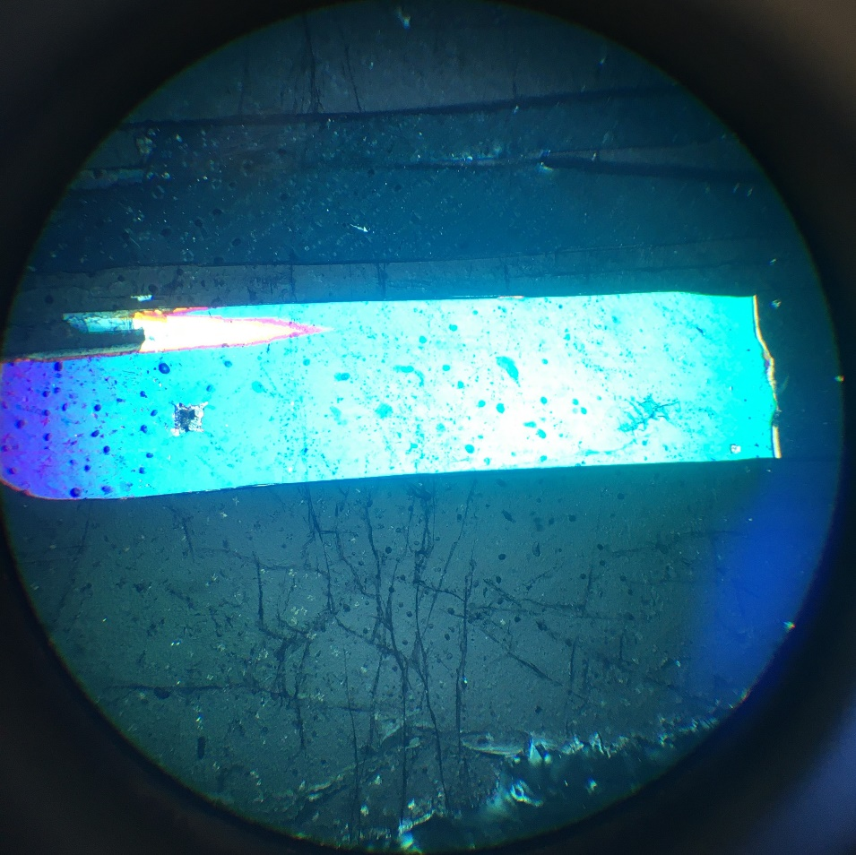
Muscovite
tourmaline
UUOP 4.3
Tourmaline (cyclosilicate)

Slide 6
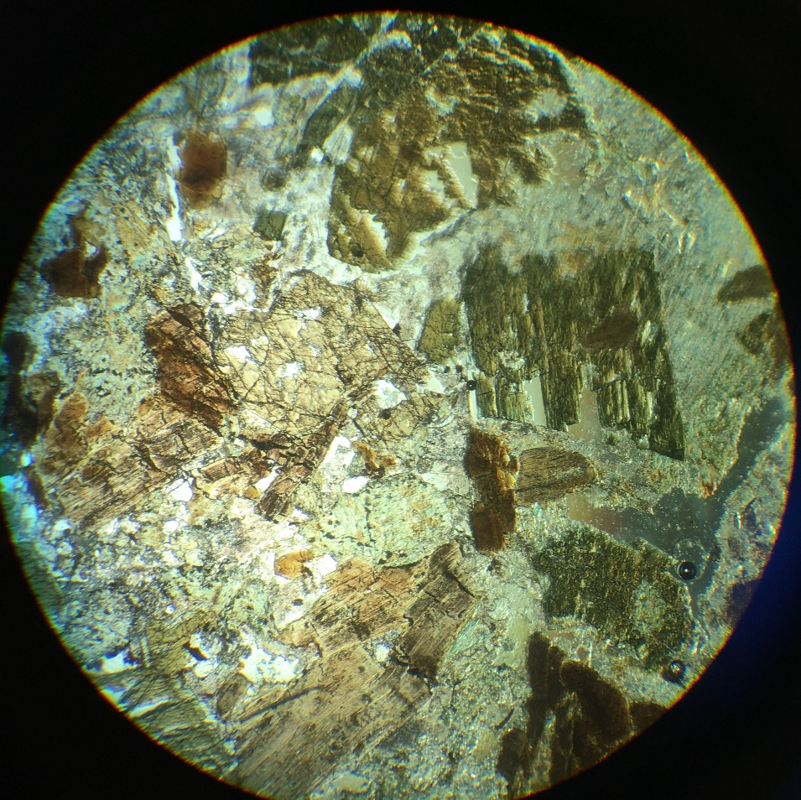
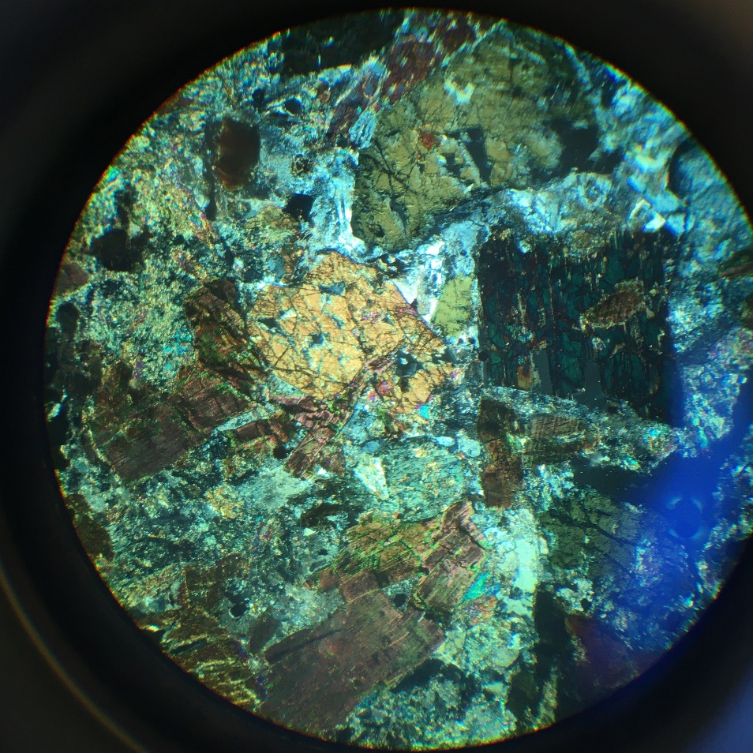
Qz
aegerine
hornblende
biotite
UUOP 5.6
hornblende (amphibole - inosilicate):Ca₂(Mg, Fe, Al)₅ (Al, Si)₈O₂₂(OH)₂

Slide 7
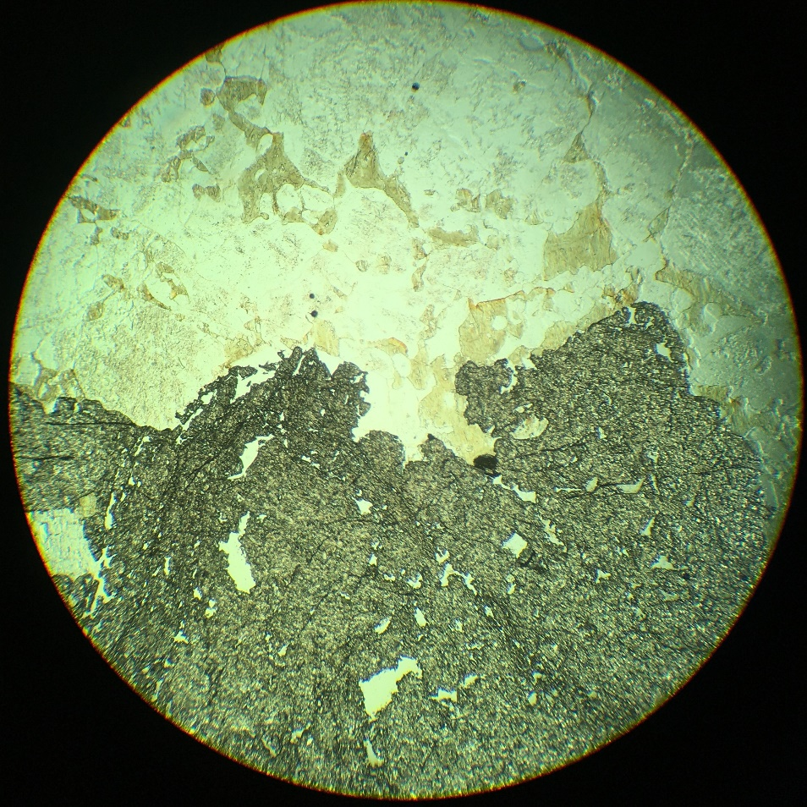
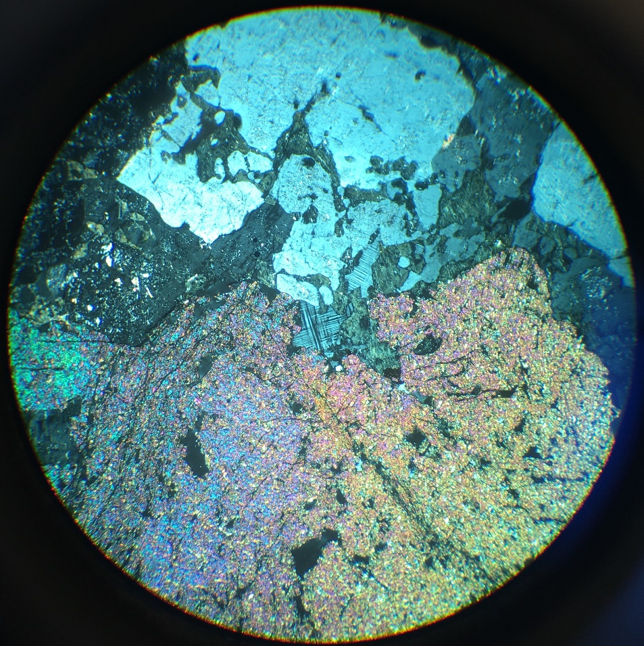
Qz
muscovite
Chlorite
aegerine
orthoclase
microcline
sphene
UUOP 6.9
sphene (or titanite - nesosilicate): CaTiSiO₅

Slide 8
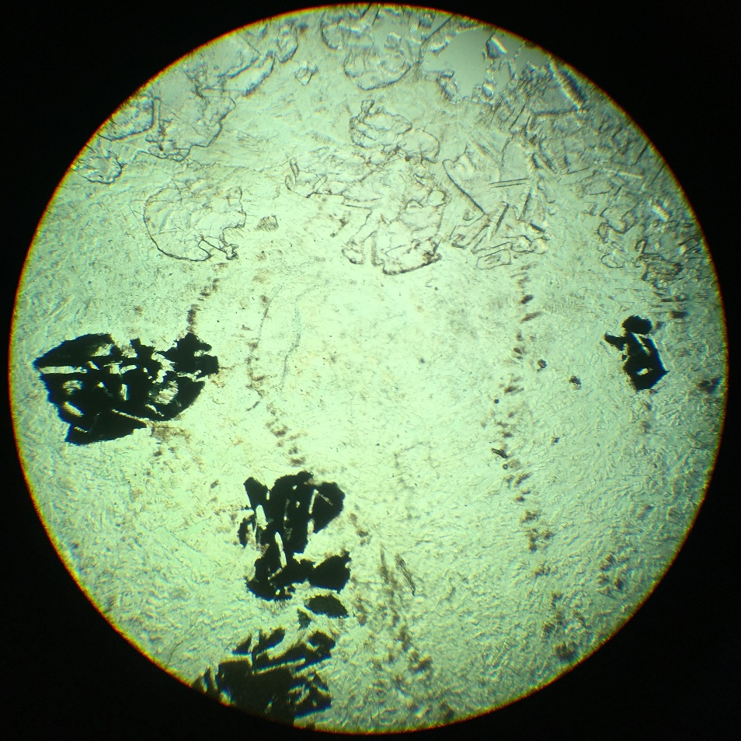
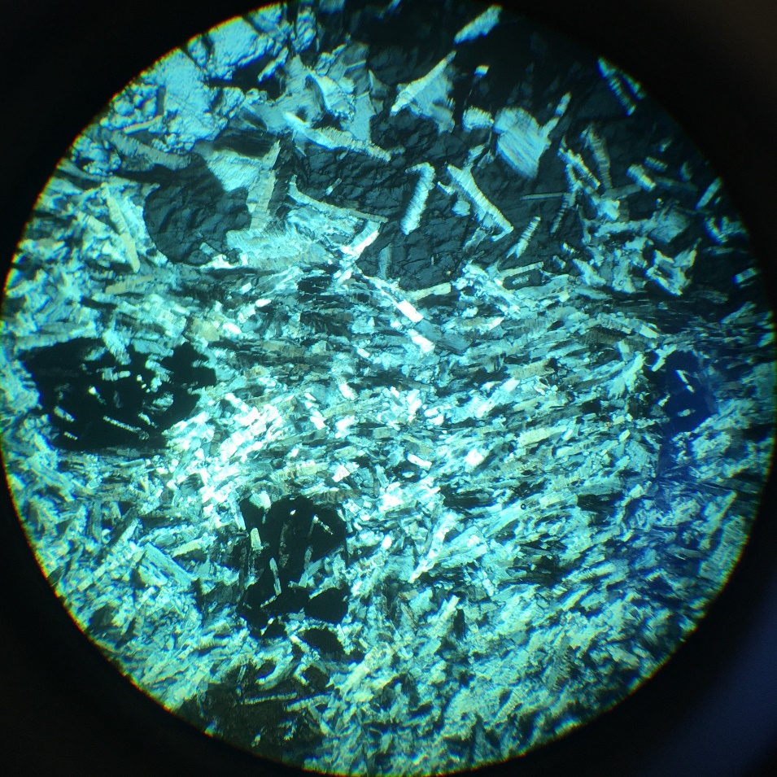
sodalite
aegerine
alkali feldspar
UUOP 8.1
sodalite (tectosilicate – feldspathoid)

Slide 9
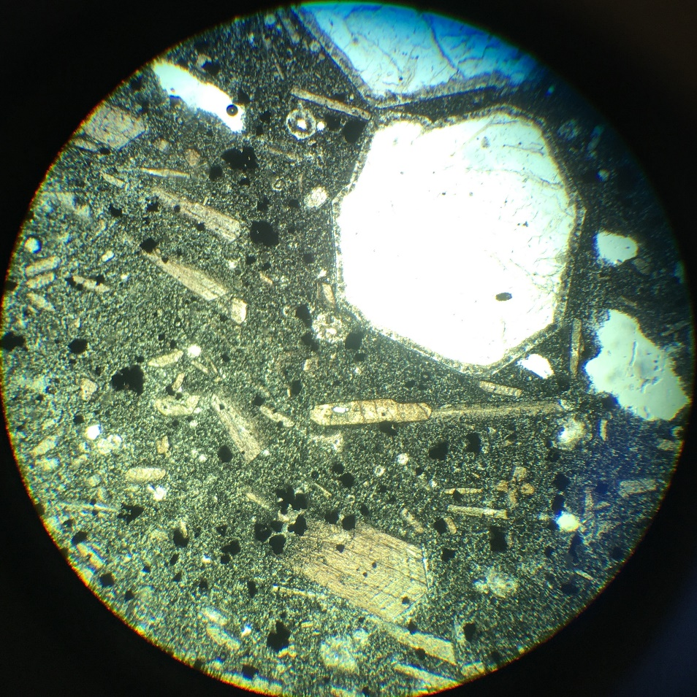
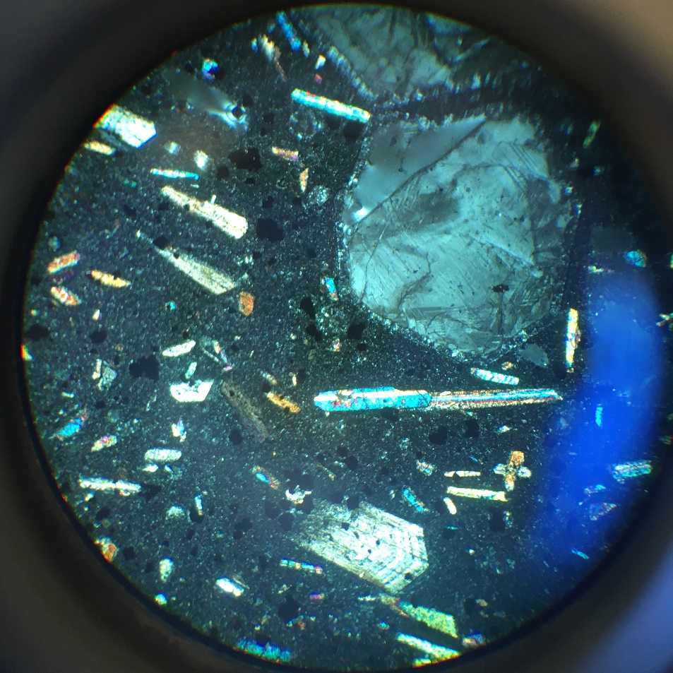
leucite
Basaltic glass
augite
UUOP 9.9
leucite (tectosilicate – feldspathoid): K[AlSi₂O₆]

Slide 10
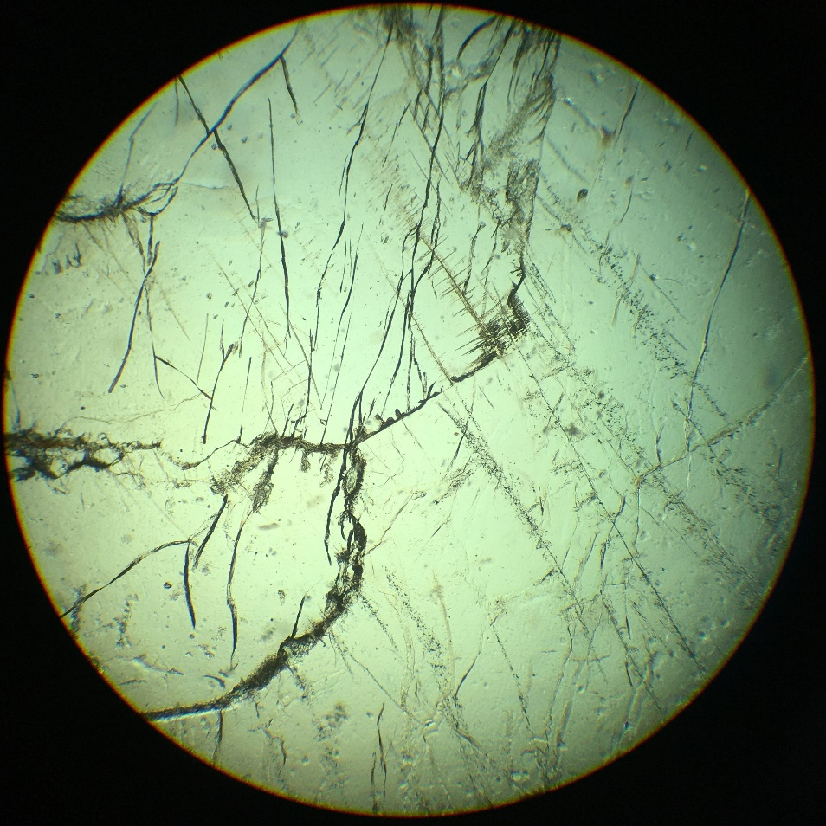
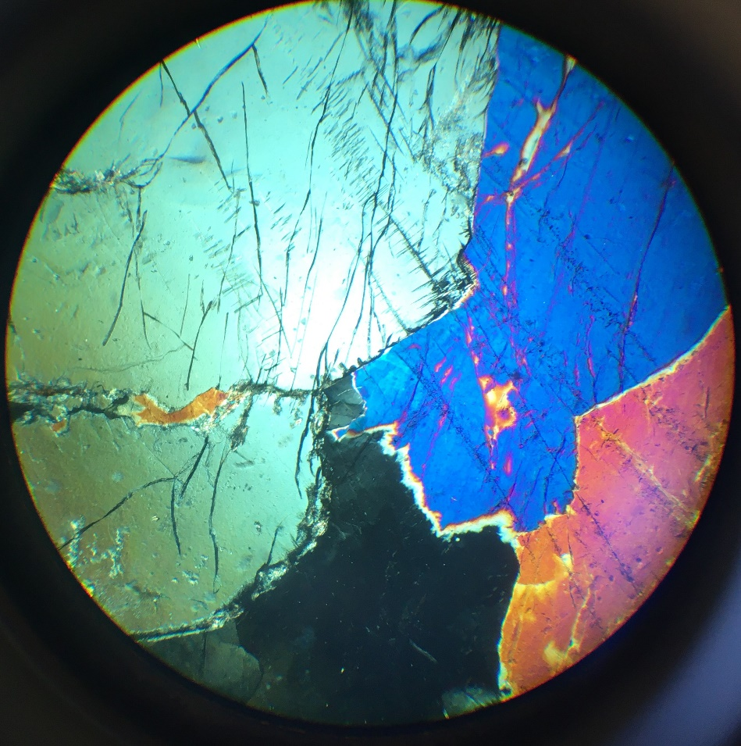
UUOP 10.2
cordierite (cyclosilicate): (Mg,Fe)2Al4Si5O18

Slide 11
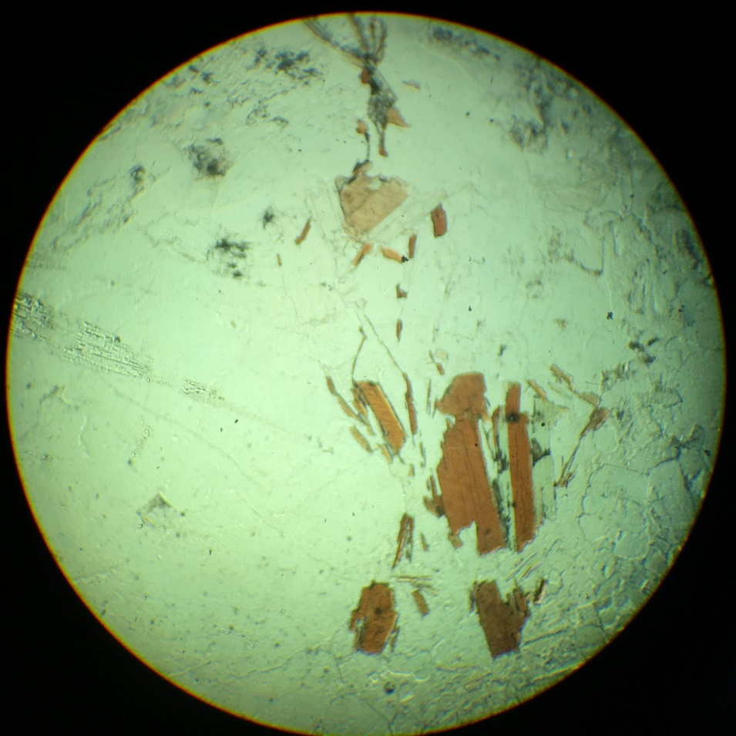
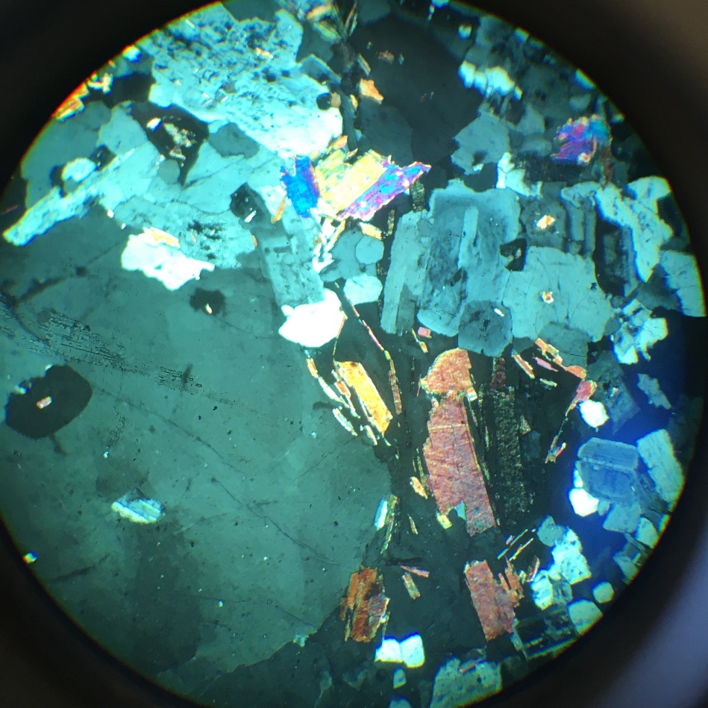
orthoclase
muscovite
quartz
chlorite
biotite
biotite
UUOP 11.3
orthoclase (tectosilicate): KAlSi3O8

Slide 12
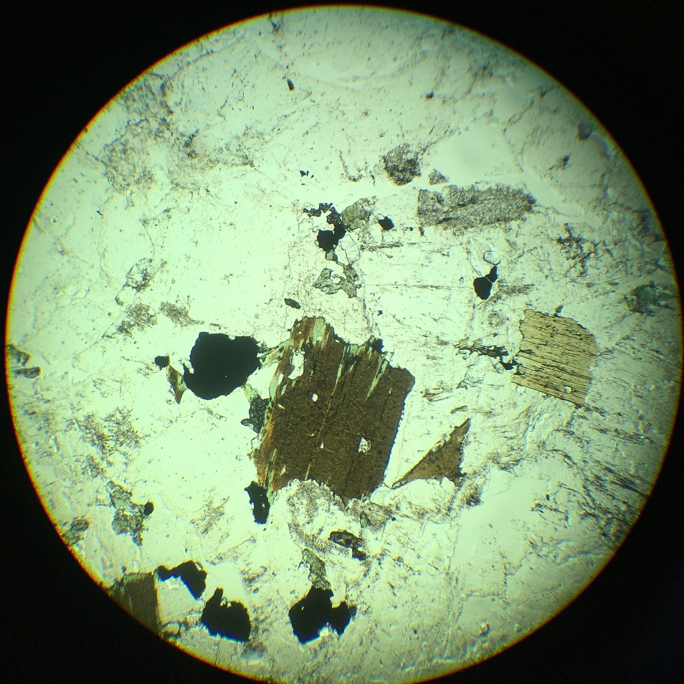
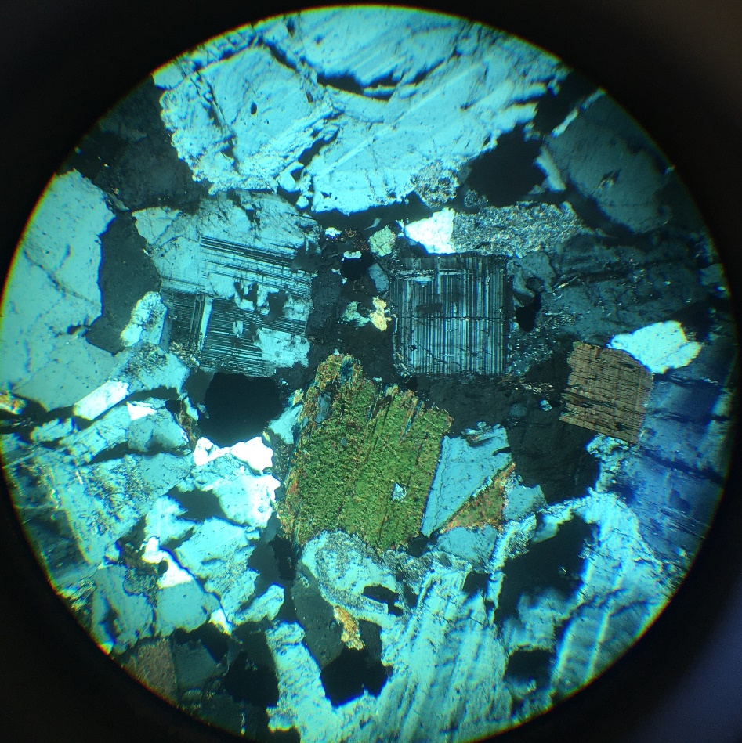
sphene
Qz
apatite
microcline
biotite
UUOP 12.9
apatite (phosphate): Ca₅(PO₄)₃(F,Cl,OH)

Slide 13
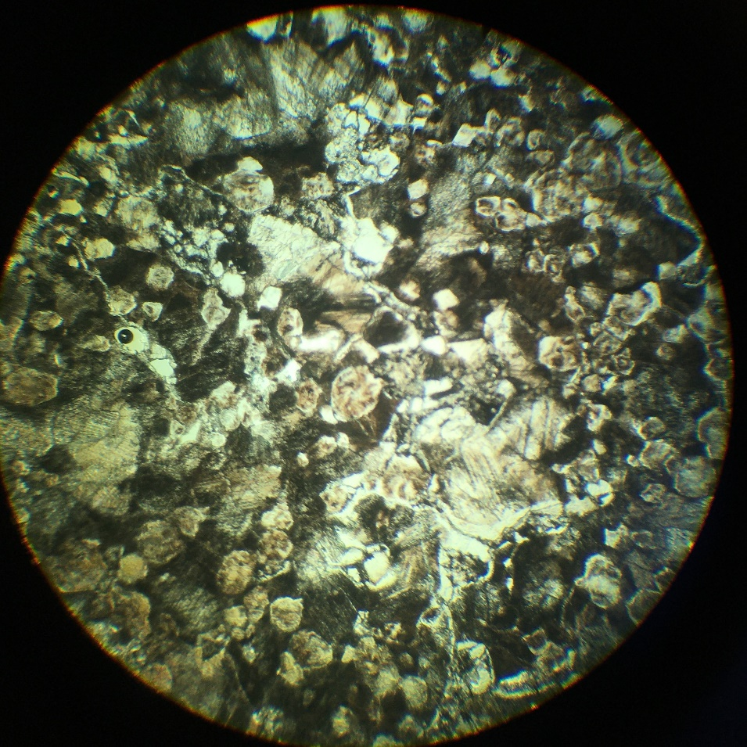
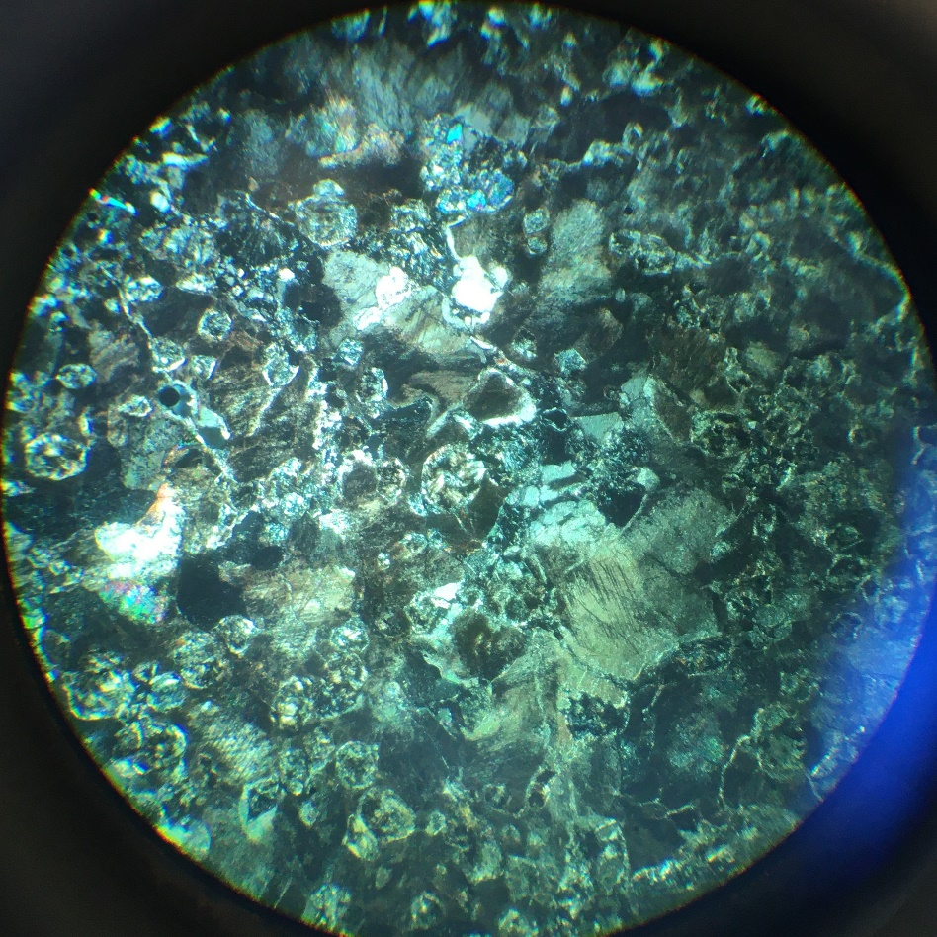
UUOP 13.1
brucite (hydroxide): Mg(OH)₂

Slide 14
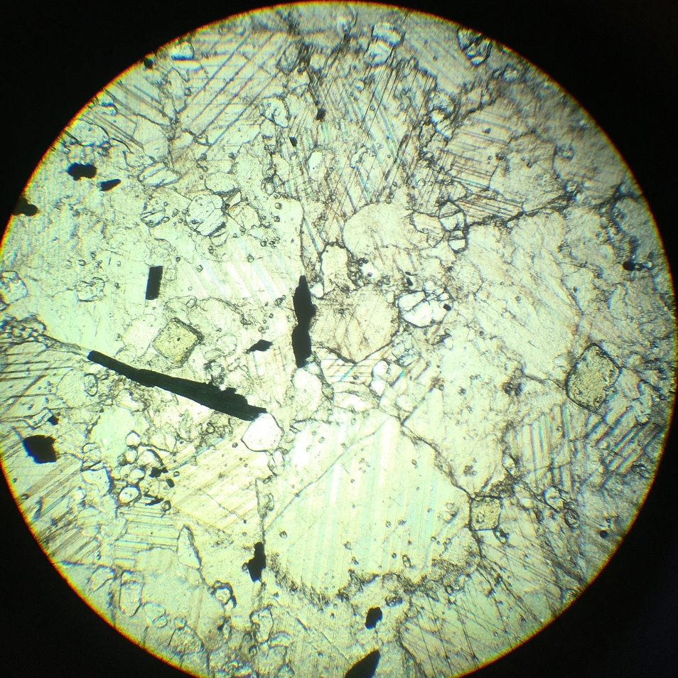
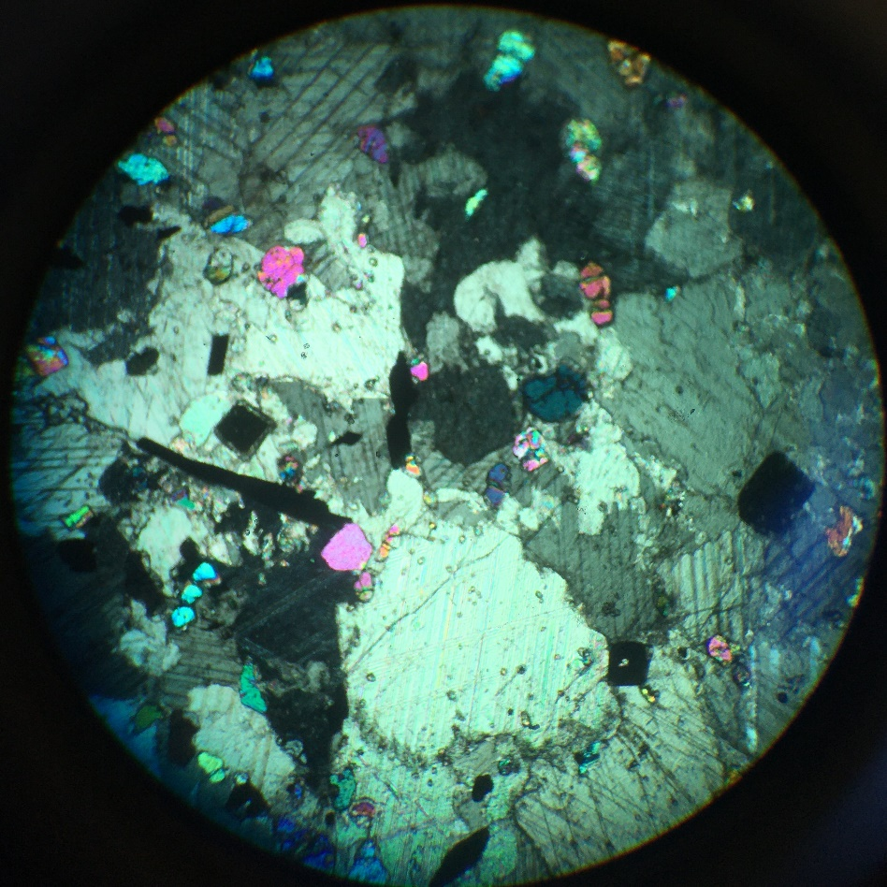
dolomite
spinel
periclase
Olivine (∼ pure Fo)
calcite
UUOP 14.4
calcite (carbonate): CaCO3

Slide 15
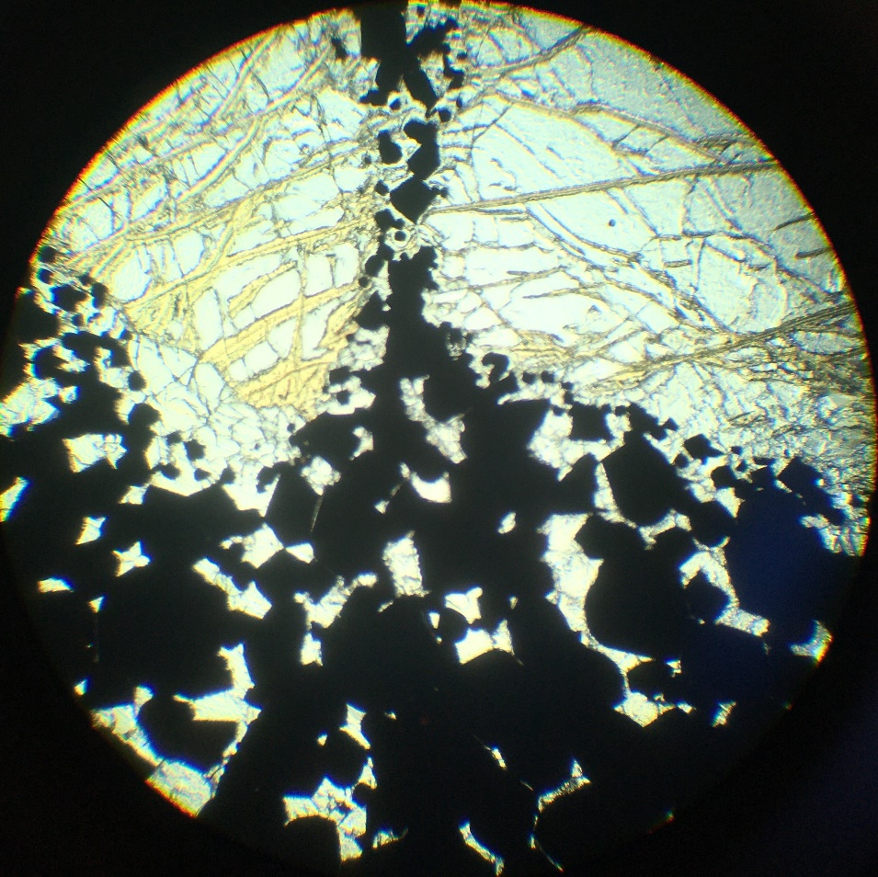
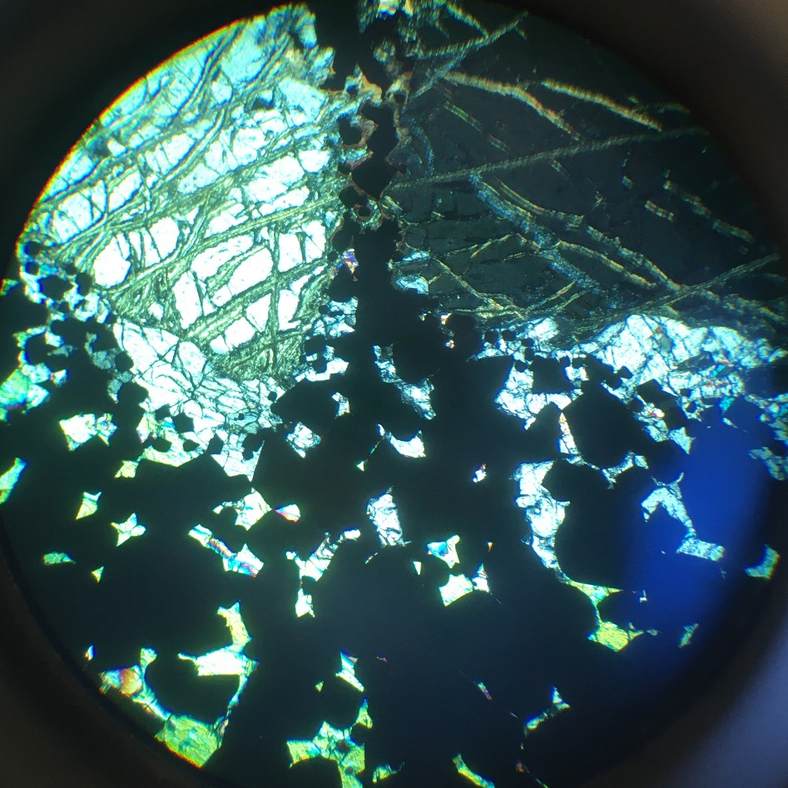
Olivine
(serpentinized)
opx
Chromite
UUOP 15.5
Chromite (oxide – spinel group): (Fe, Mg)Cr₂O₄

Slide 16
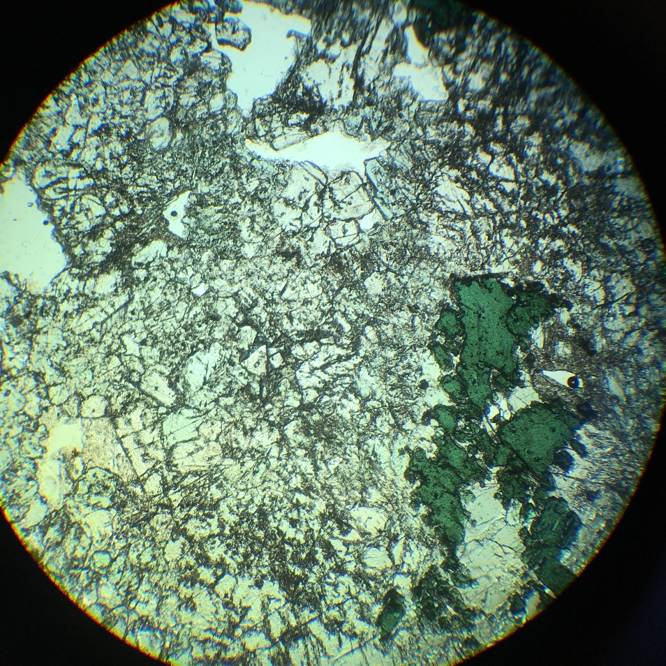
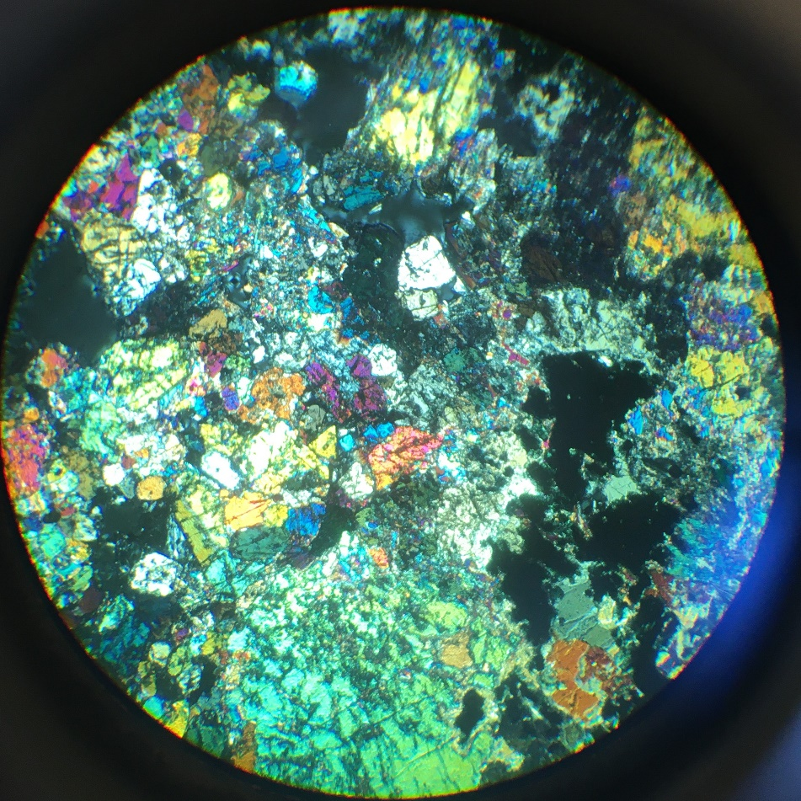
Olivine
spinel
Ti-diopside
UUOP 16.4
Cr-Spinel (oxide)

Slide 17
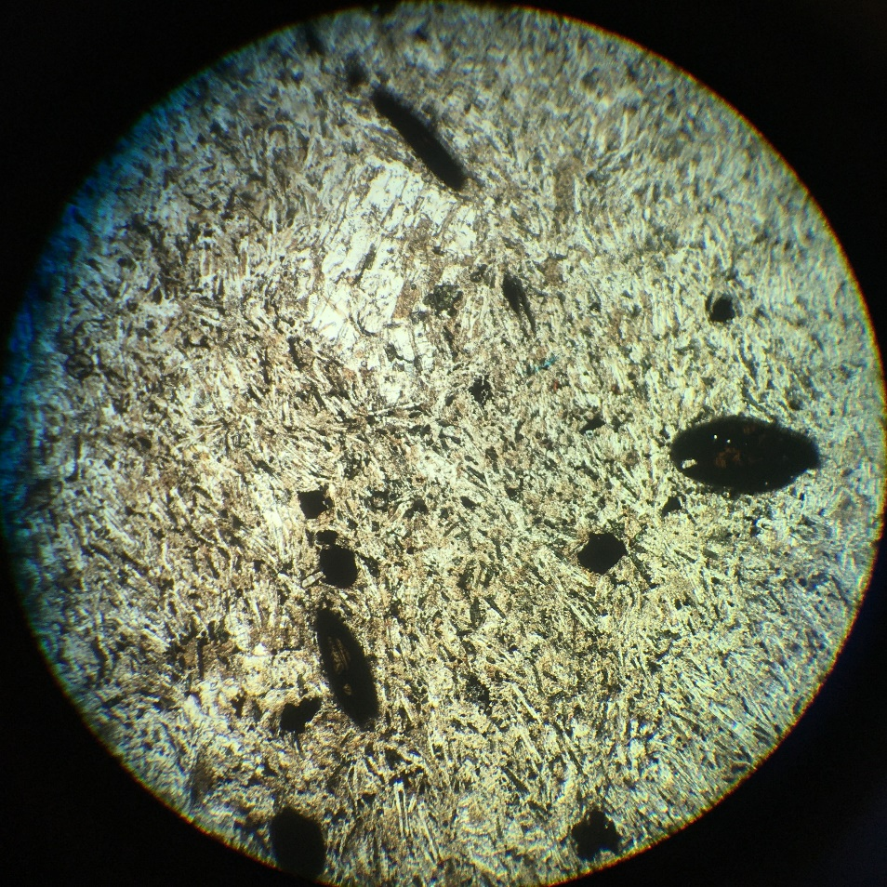
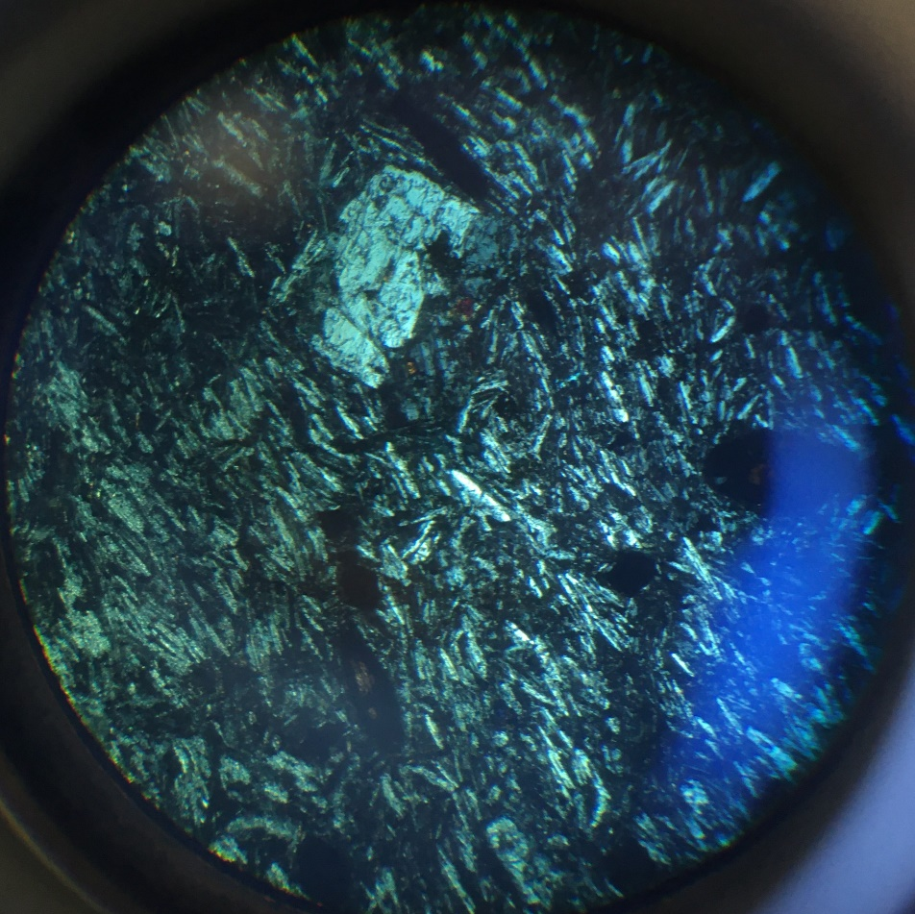
plag
Hauyne
biotite
oxyhornblende
UUOP 17.6
Hauyne (tectosilicate – feldspathoid)
(oxyhornblende = brown hornblende)

Slide 18
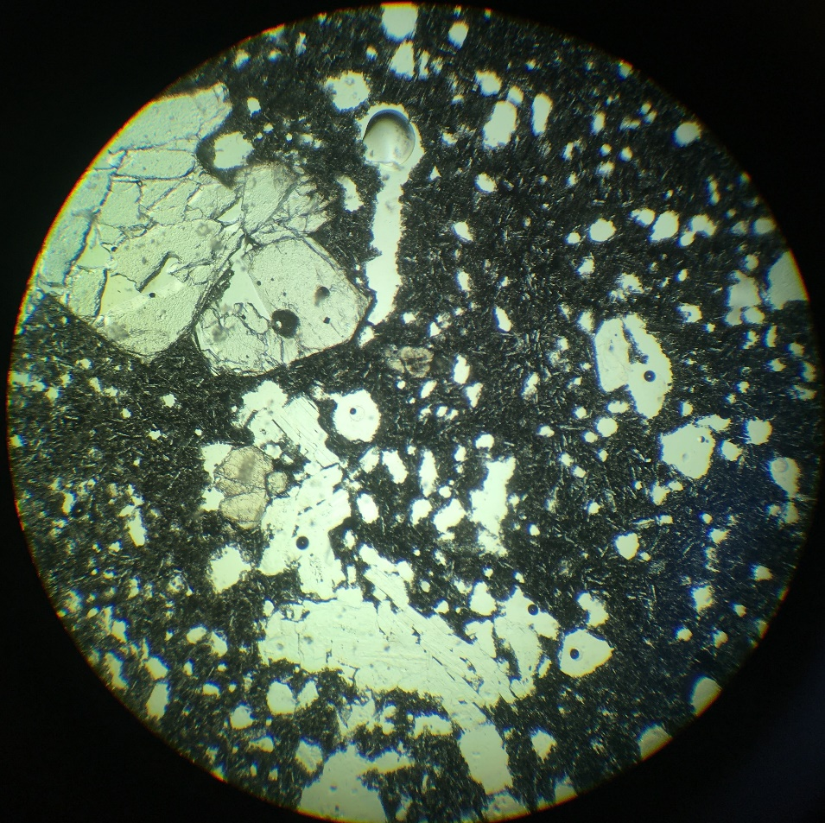
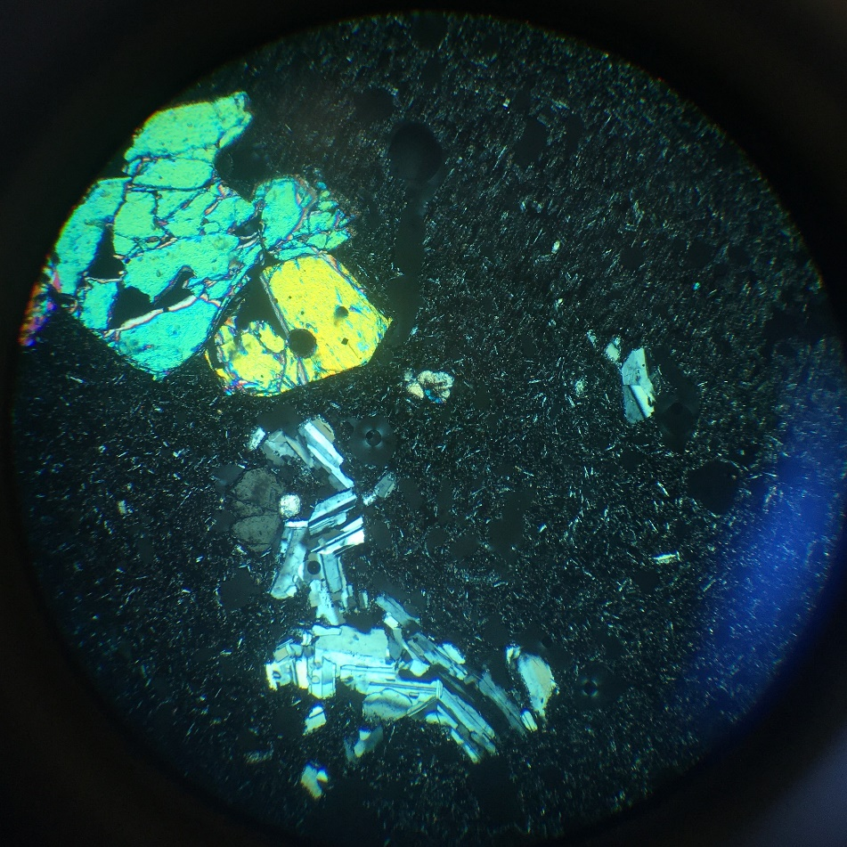
olivine
glass
augite
plag
UUOP 18.2
olivine (nesosilicate): (Mg,Fe)2SiO4

Slide 19
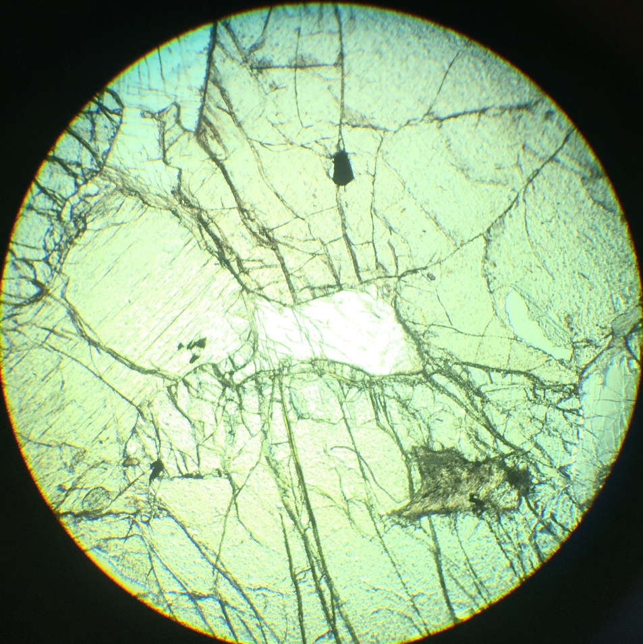
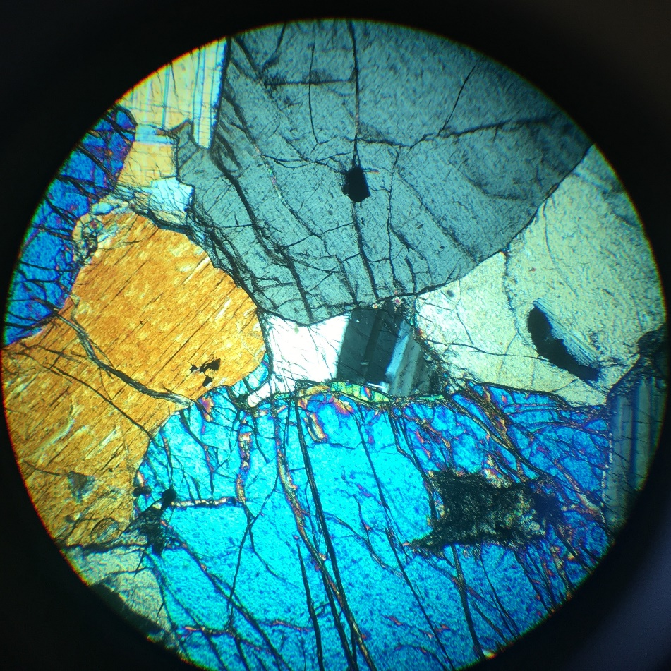
opx
spinel
plag
diopside
olivine
UUOP 18.6
orthopyroxene (inosilicate): (Mg,Fe)SiO3

Slide 20
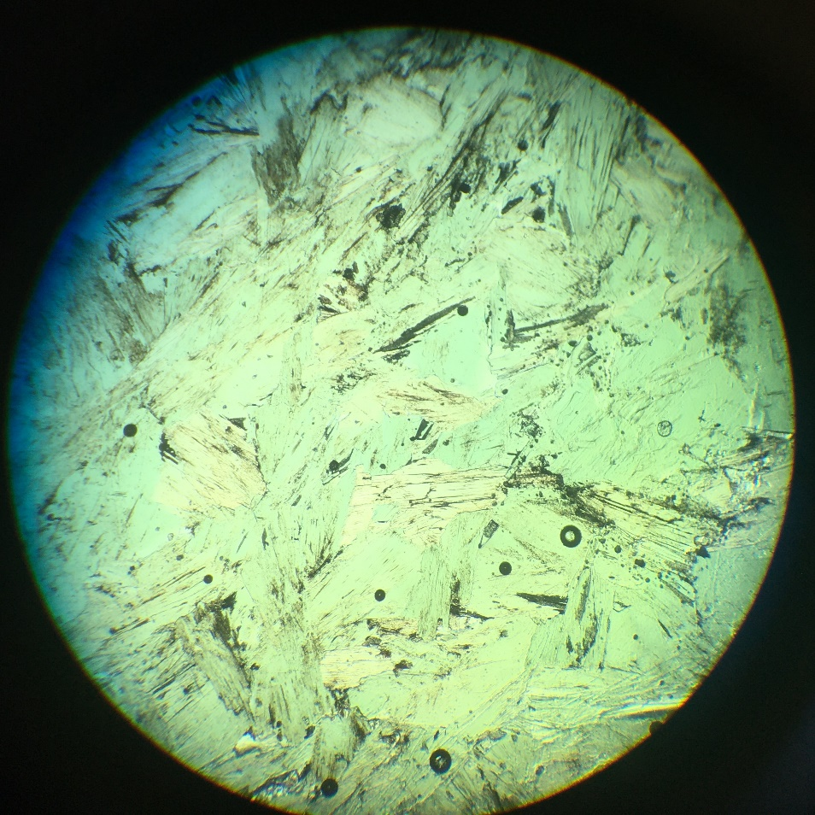
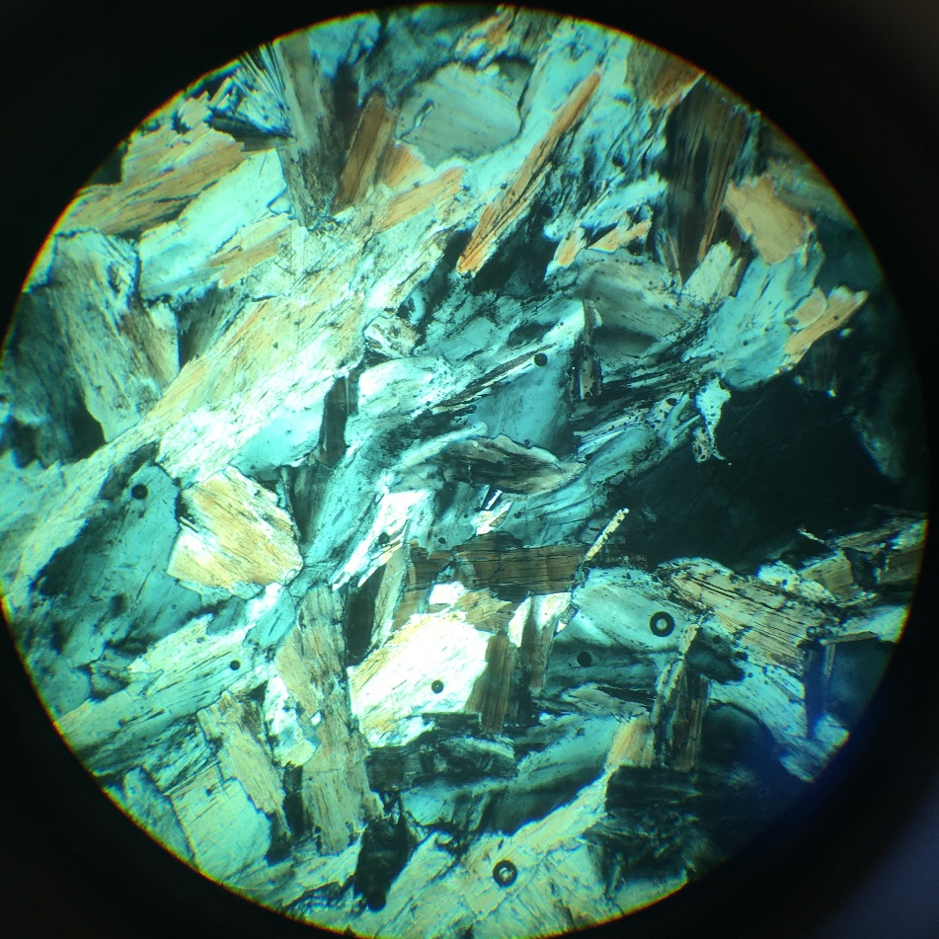
UUOP 19.8
Chlorite (inosilicate – TOT+O)

Slide 21
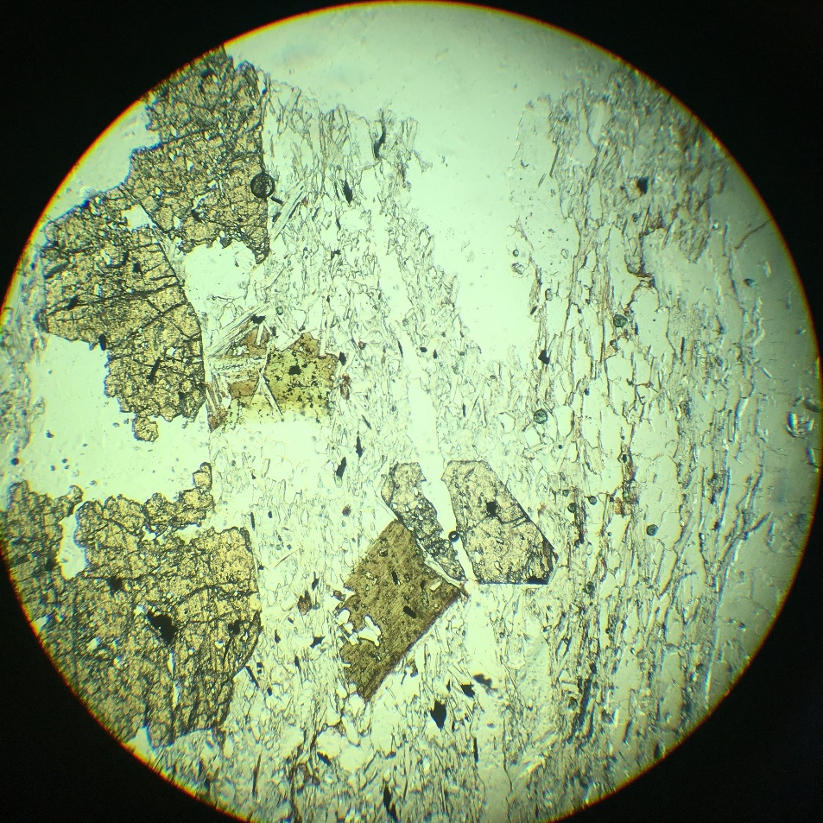
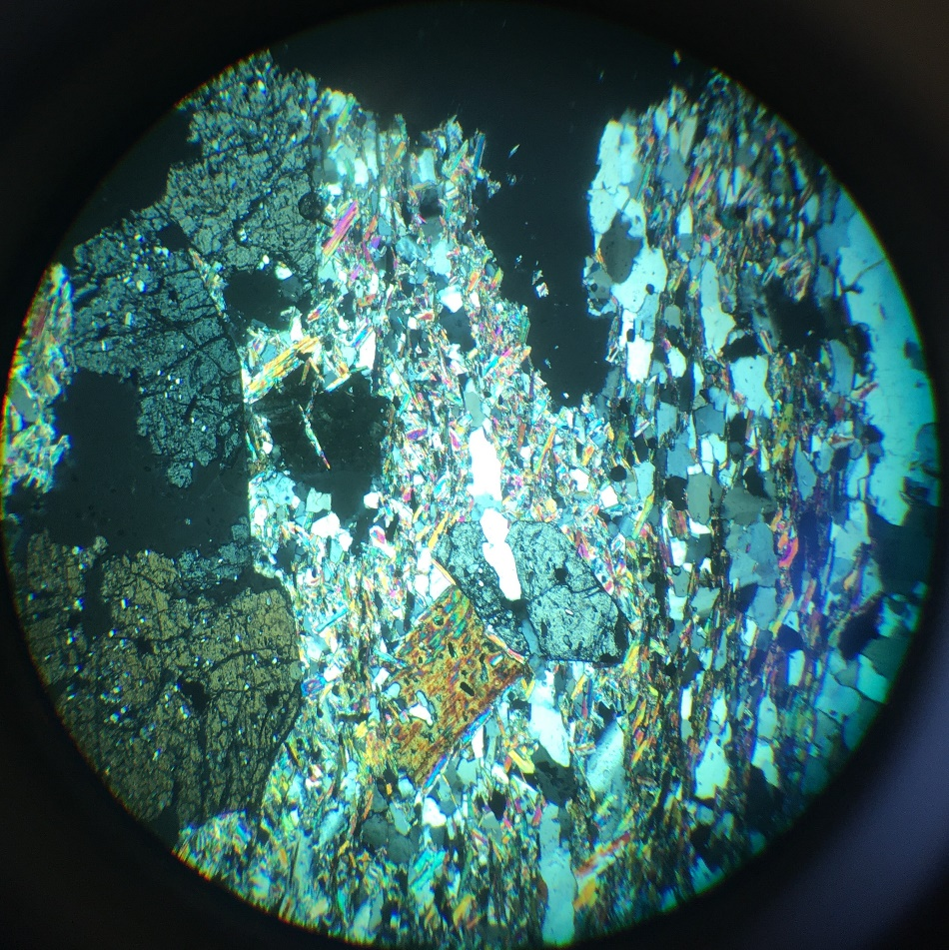
Musc
Qz
sphene
staurolite
biotite
UUOP 20.10
Staurolite (nesosilicate)

Slide 22
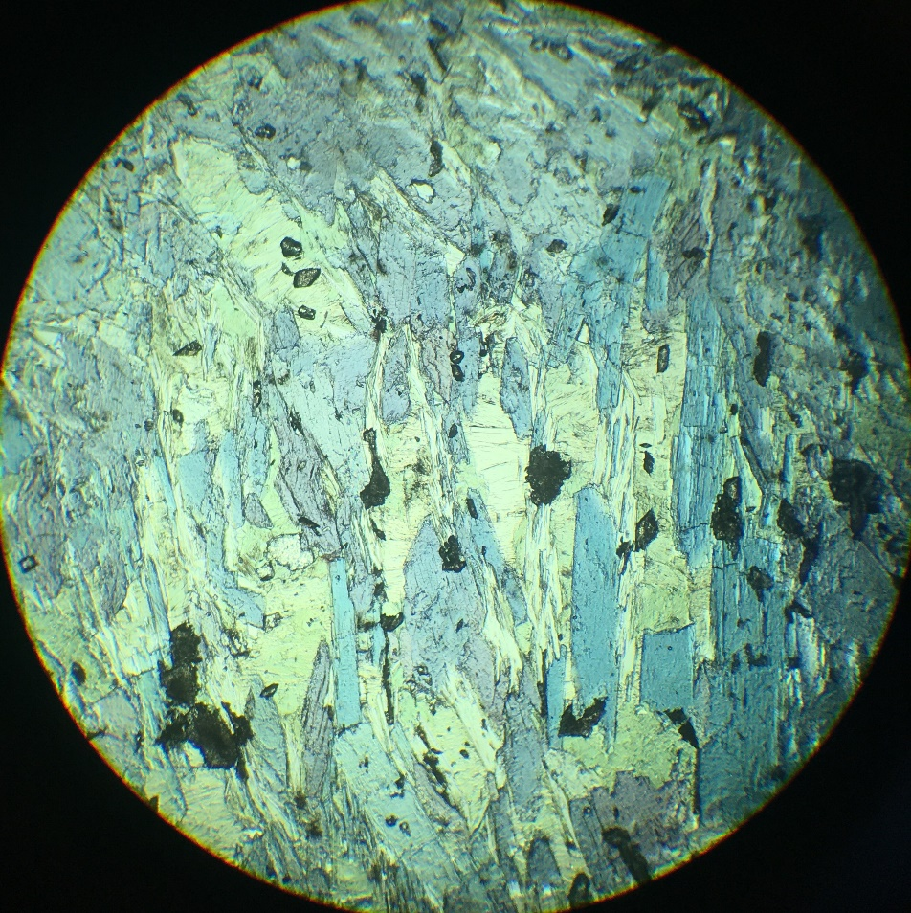
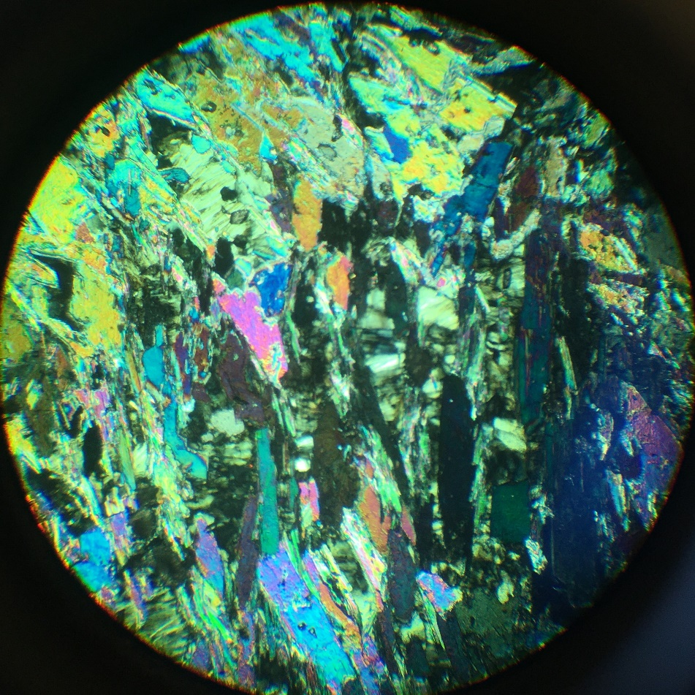
chlorite
glaucophane
sphene
Qz
phengite
UUOP 21.3
Glaucophane (inosilicate – sodic amphibole)
(phengite = white micas high pressure)

Slide 23
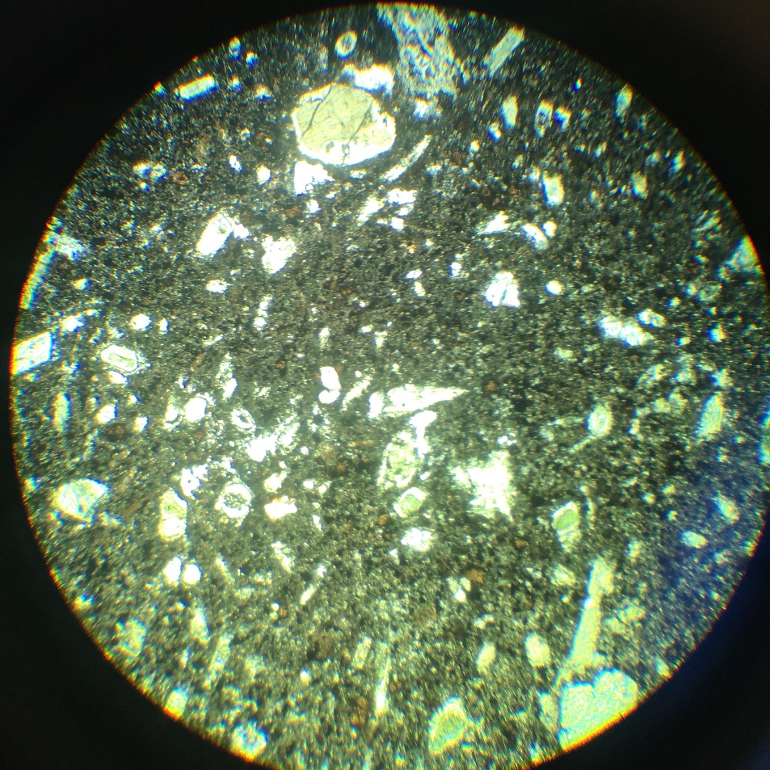
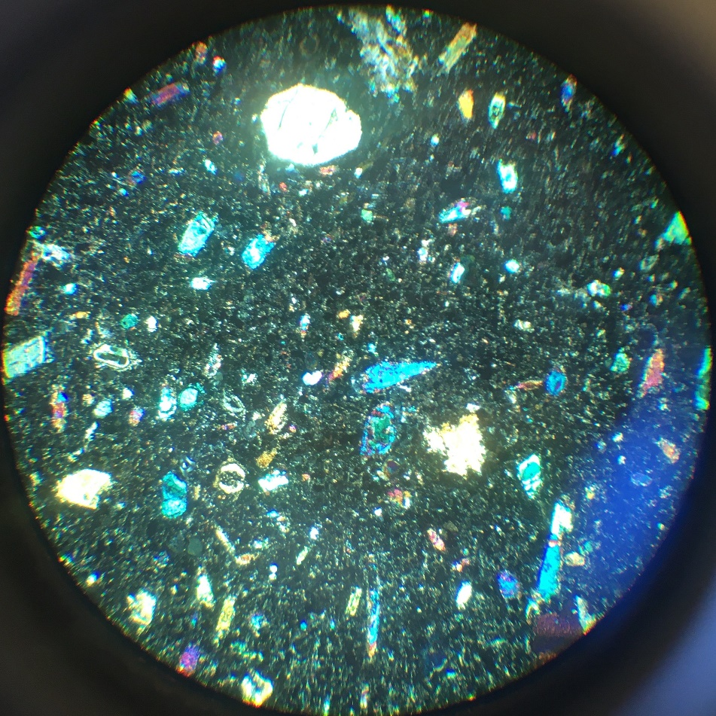
augite
olivine
UUOP 22.1
Augite (inosilicate – clinopyroxene): (Ca,Na)(Mg,Fe,Al,Ti)(Si,Al)₂O₆

Slide 24
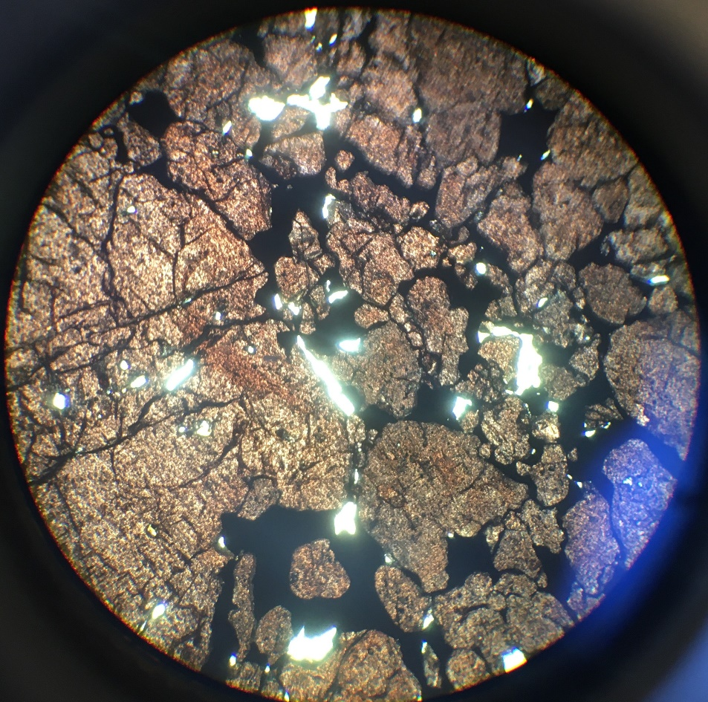
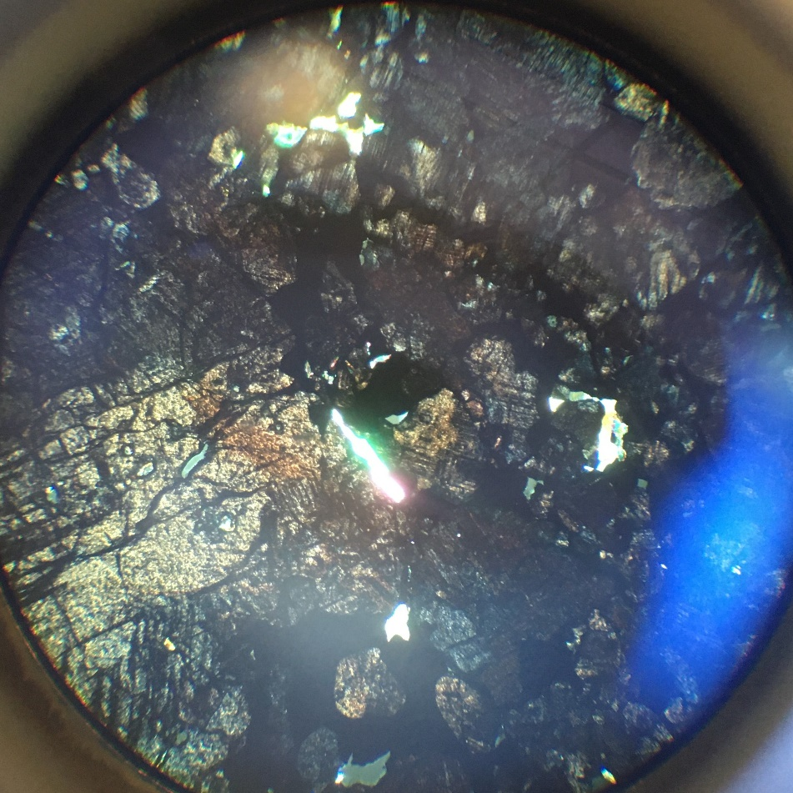
muscovite
perovskite
magnetite
UUOP 22.5
Perovskite (oxide): CaTiO₃

Slide 25
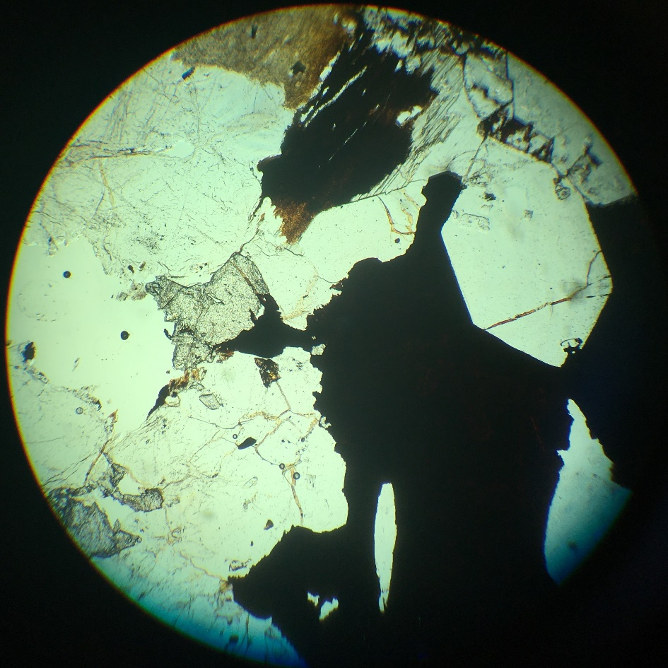
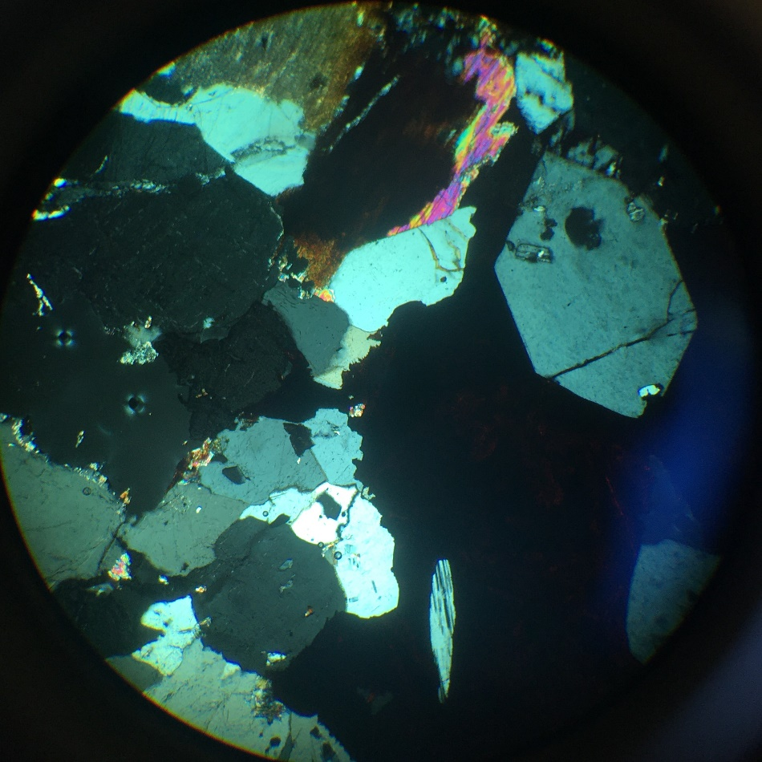
biotite
plag
beryl
quartz
fluorite
rutile
UUOP 23.5
Beryl (cyclosilicate): Be₃Al₂Si₆O₁₈

Slide 26


qz
augite
biotite
apatite
UUOP 24.3
Biotite (phyllosilicate - T-O-T +cation): K(Mg,Fe)₃(AlSi₃O₁₀)(F,OH)₂
(note: slides 24 are too thick)

Slide 27


Qz
qz
glaucophane
graphite
UUOP 25.9
Glaucophane (inosilicate – sodic amphibole)

Slide 28


diopside
phlogopite
olivine
UUOP 26.6
Phlogopite (phyllosilicates – biotite group)

Slide 29




hornblende
rutile
qz
UUOP 27.7
Hornblende (inosilicate – amphibole)

Slide 30


qz
fluorite
calcite
aegirine
UUOP 28.7
Aegirine (inosilicate – sodic clinopyroxene)

Slide 31


calcite
tremolite
UUOP 29.9
tremolite (inosilicate – colorless amphibole)

Slide 32




biotite
calcite
zircon
garnet
qz
UUOP 30.8
Biotite (phyllosilicate - T-O-T +cation): K(Mg,Fe)₃(AlSi₃O₁₀)(F,OH)₂
Zircon with radiation hallo

Slide 33


biotite
apatite
qz
horn
plag
orthoclase
UUOP 31.4
Plagioclase (tectosilicate): NaAlSi₃O₈ – CaAl₂Si₂O₈

Slide 34


biotite
muscovite
qz
orthoclase
UUOP 32.5
Biotite (phyllosilicate - T-O-T +cation): K(Mg,Fe)₃(AlSi₃O₁₀)(F,OH)₂

Slide 35


qz
stilpnomelane
Garnet (spess.)
UUOP 33.4
stilpnomelane (phyllosilicate – dark micas)

Slide 36


plag
olivine
iddingsite
opx
UUOP 34.5
iddingsite (NA): (alteration product of olivine)

Slide 37


sill
muscovite
kyanite
sillimanite
orthoclase
UUOP 35.10
Kyanite (nesosilicate – aluminum silicate): Al2SiO5

Slide 38


Qz
Chloritized biotite
microcline
muscovite
orthoclase
UUOP 36.8
Microcline (tectosilicate – K-felsdpar): KAlSi3O8

Slide 39


Qz + biotite + muscovite
garnet
Staurolite
UUOP 37.9
garnet (nesosilicate): X₃Y₂(SiO₄)₃

Slide 40


calcite
biotite
augite
olivine
UUOP 38.4
calcite (carbonate): CaCO3
(note: thin sections are too thick)

Slide 41


quartz
topaz
calcite
UUOP 39.7
topaz (nesosilicate)

Slide 42


UUOP 40.5
sodalite (tectosilicate – feldspathoid) – single crystal

Slide 43


calcite
olivine
UUOP 41.2
sphalarite (sulfide)

Slide 44


UUOP 42.3
opal (mineraloid)

Slide 45


nepheline
olivine
plag
UUOP 43.10
nepheline (tectosilicate - feldspathoid)

Slide 46


calcite
epidote
UUOP 44.7
epidote (sorosilicate)

Slide 47


UUOP 45.5
calcite (carbonate): CaCO3 – single crystal

Slide 48


UUOP 46.1
topaz (nesosilicate) – single crystal

Slide 49


UUOP 52.7
vesuvianite (sorosilicate)

Slide 50


Ti-augite
olivine
melilite
UUOP 53.3
melilite (sorosilicate)

Slide 51


biotite
Musc.
microcline.
qz.
UUOP 54.4
microcline (tectosilicate – K-felsdpar): KAlSi3O8

Slide 52


microcline.
qz.
Hornb.
biotite.
UUOP 55.5
microcline (tectosilicate – K-felsdpar): KAlSi3O8

Slide 53


glass
qz
microcline.
biotite
sanidine
UUOP 56.4
sanidine (tectosilicate – K-felsdpar): KAlSi3O8

Slide 54


UUOP 57.2
Partly devitrified volcanic glass

Slide 55


plag
opx.
augite
UUOP 58.1
Hyperstene (opx; inosilicate): (Mg, Fe)SiO3

Slide 56


UUOP 59.6
tremolite (inosilicate – colorless amphibole)

Slide 57


horn
biot
plag
UUOP 60.7
Biotite (phyllosilicate - T-O-T +cation): K(Mg,Fe)₃(AlSi₃O₁₀)(F,OH)₂

Slide 58


biotite
orthoclase
sphene
plag
UUOP 61.3
Biotite (phyllosilicate - T-O-T +cation): K(Mg,Fe)₃(AlSi₃O₁₀)(F,OH)₂

Slide 59


sanidine
plag
UUOP 63.3
sanidine (tectosilicate – K-felsdpar): KAlSi3O8

Slide 60


glass
plag
qz
UUOP 64.9
Volcanic glass (in ignimbrite)

Slide 61


UUOP 65.5
sanidine (tectosilicate – K-felsdpar): KAlSi3O8
With Carlsbad twin in glass

Slide 62


Haüyne
UUOP 66.2
Hauyne (tectosilicate – feldspathoid)

